Slide 1
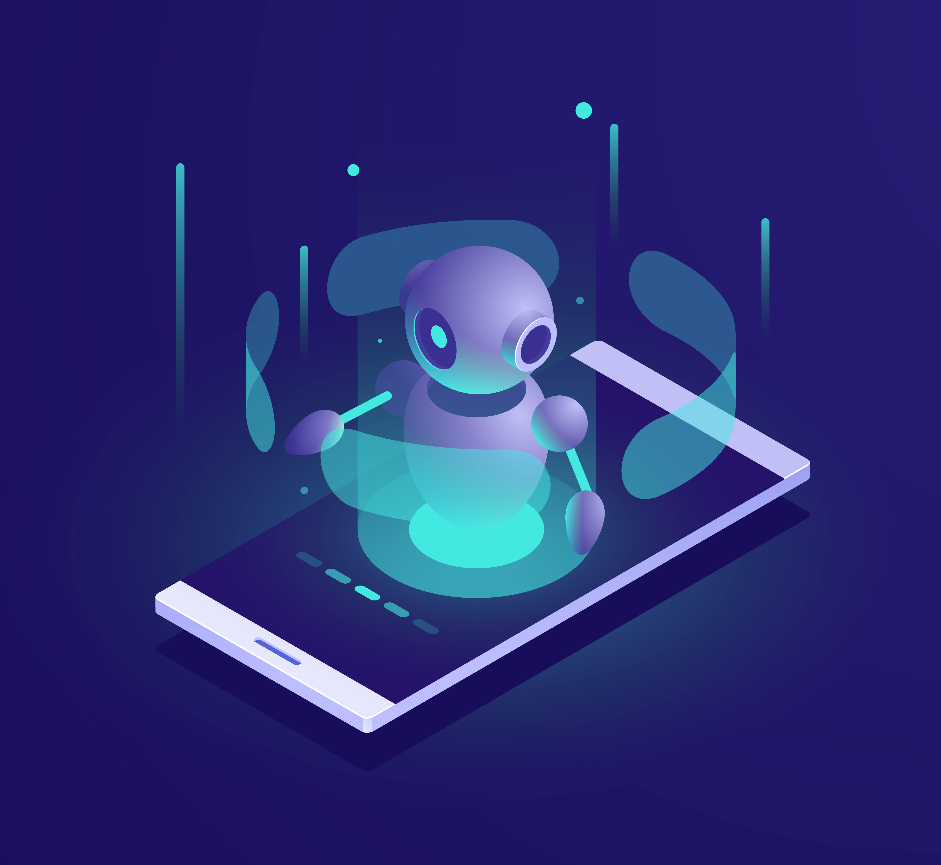
Chatbot Innovation
Presenter Name

Slide 2

Contents
Introduction
Types of chatbot
Educational field
User Experience
Social media
Conversional design
Creating a Chatbot
Summary

Slide 3


Introduction
Chatbot innovation involves the development and enhancement of chatbots, which are computer programs designed to engage in conversations with users. It focuses on creating chatbots that are more intelligent, capable, and user-friendly.

Slide 4
Types of Chatbot
Answer Bots : Chatbots that provide answers to questions.
Shopping Bots : Chatbots that help you shop online.
Scheduler Bots : Chatbots that book appointments and meetings.
Entertainment Bots : Chatbots that amuse and entertain users.
Healthcare Bots : Chatbots that offer medical advice.
Teaching Bots : Chatbots that help you learn new things.
Finance Bots : Chatbots that assist with financial tasks.

Slide 5
Educational field
Chatbot innovation in education has the potential to revolutionize the way we learn. Imagine having personalized virtual tutors that can provide immediate feedback, answer questions, and adapt to individual learning styles. Chatbots can also assist with administrative tasks, such as scheduling and course registration. Additionally, they can offer interactive learning experiences through gamification and simulations. Overall, chatbot innovation in education aims to make learning more accessible, engaging, and tailored to each student's needs. It's an exciting development that can greatly enhance the educational experience.

Slide 6
User Experience
When it comes to chatbot innovation and user experience, there are several exciting developments. Chatbots are becoming more conversational and natural in their interactions, making the user experience feel more human-like. They are also incorporating visual elements like images and videos to enhance engagement. Additionally, chatbots are leveraging user data and preferences to provide personalized recommendations and tailored experiences. These advancements aim to create seamless and enjoyable interactions, ultimately improving the overall user experience with chatbots.

Slide 7
Social media
Chatbot innovation in social media has been significant. Social media platforms are integrating chatbots to enhance user engagement and provide personalized experiences. Chatbots can assist with customer support, answer inquiries, and offer recommendations based on user preferences. They can also facilitate transactions and provide real-time updates. Additionally, chatbots are being used to create interactive and entertaining experiences, such as interactive games or virtual assistants within social media apps. Overall, chatbot innovation in social media aims to improve user interactions, streamline processes, and enhance the overall user experience

Slide 8
Conversational Design
Chat Flow : Plan how conversations with your chatbot will flow. Like a friendly chat.
User-Centric : Focus on what users need and want, so it's helpful.
Clear Language : Use simple, understandable words in responses.
Listening Skills : Make the chatbot listen to users and respond accordingly.
Natural Interaction : Design it to feel like chatting with a real person.
Guidance : Help users find information or complete tasks smoothly.

Slide 9
Creating a Chatbot
Plan: Decide what your chatbot will do.
Build: Create your chatbot using tools.
Test: Make sure it works well.
Launch: Release it for people to use.
Improve: Listen to feedback and make it better.
Keep It Running: Maintain and update it.

Slide 10

Summary
Conversational design is crucial, making chatbots talk and listen like friendly helpers. The user interface should be easy to use, and content includes messages, information, media, questions, commands, data storage, and regular updates. These elements together create a helpful and engaging chatbot.

Slide 11
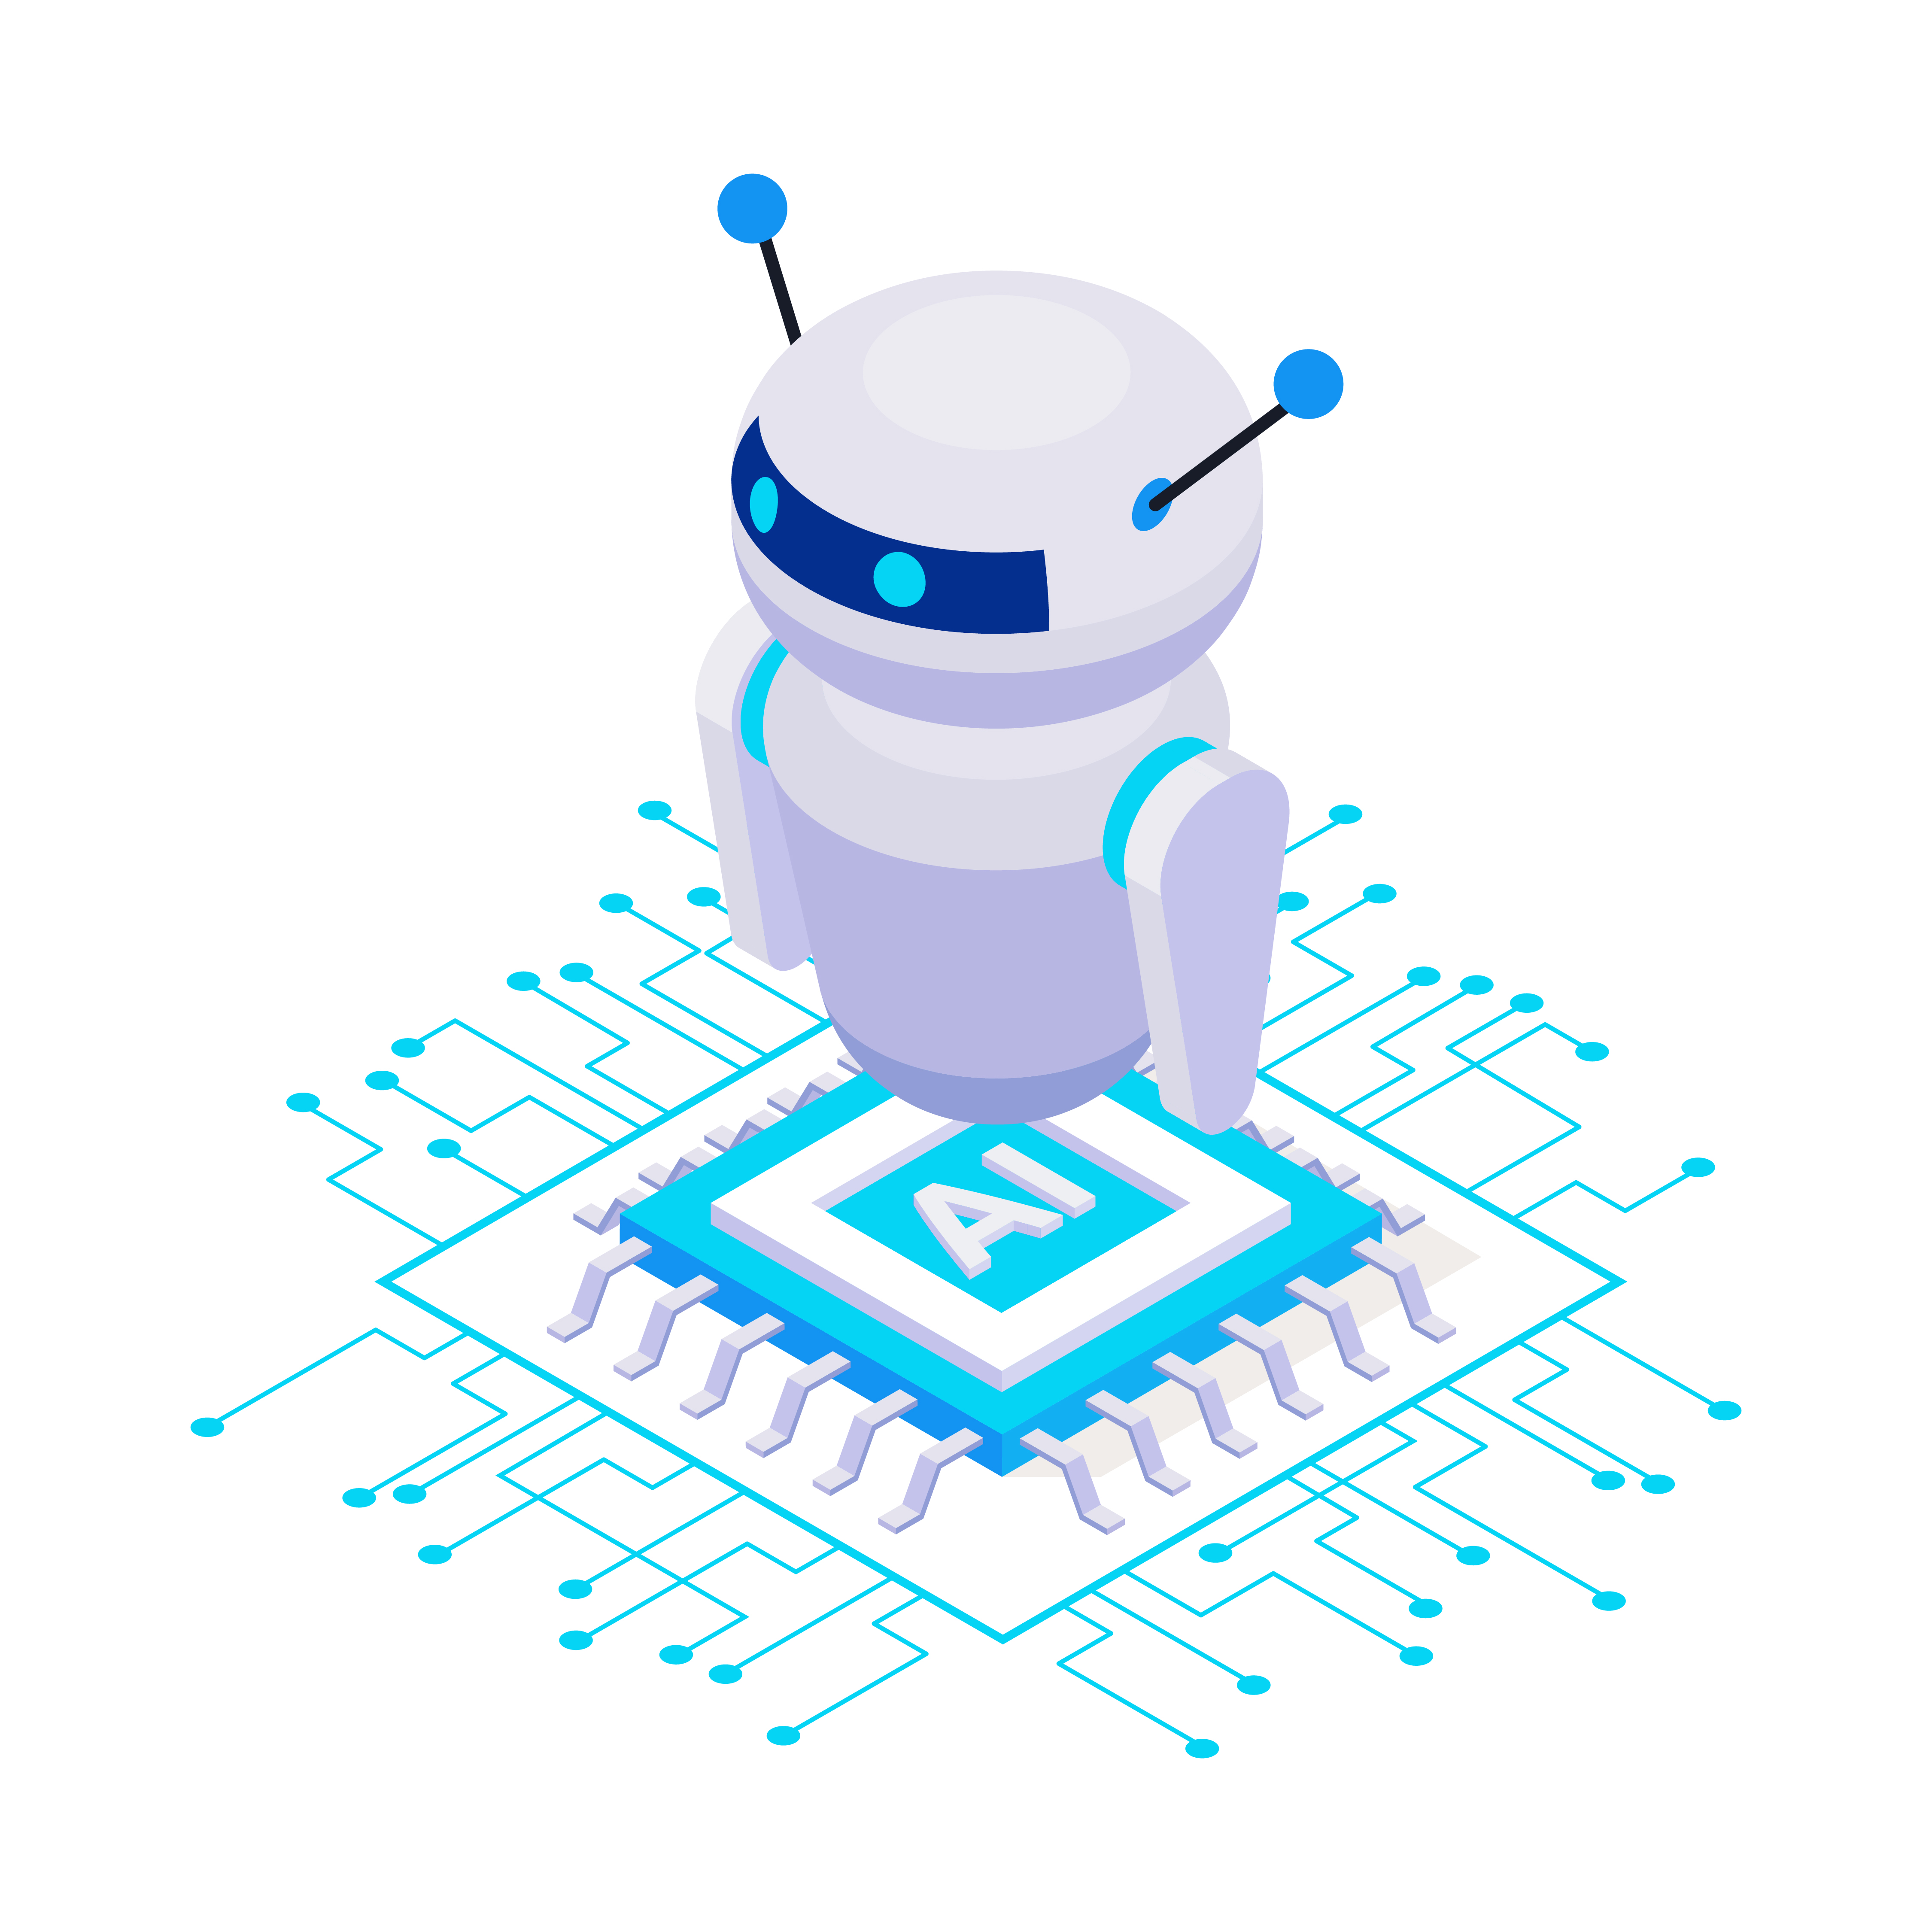
Thank You

